Slide 1
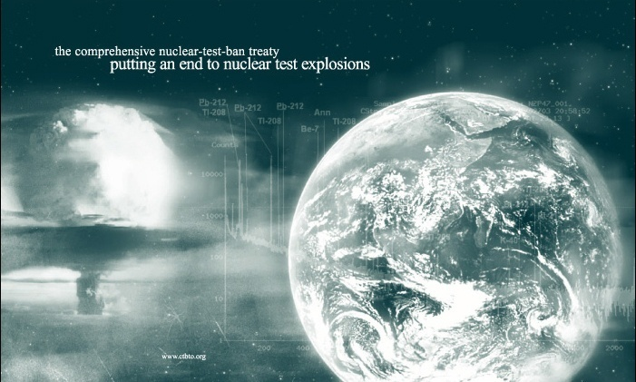
The International Monitoring System:
status and challenges
David Jepsen, Coordinator
International Monitoring System Division
Preparatory Commission for the Comprehensive Nuclear-Test-Ban Treaty Organization
Vienna International Centre
P.O. Box 1200
A-1400 Vienna
AUSTRIA
david.jepsen@ctbto.org

Slide 2
IMS – Current status
IMS status
292 stations, 31 NG systems, 16 RN labs
in situ

Slide 3
Capable IMS – DPRK4
Primary associated
detections
Primary no detection
Auxiliary associated
detections
Auxiliary not used
Notes:
IMS Primary and auxiliary seismic stations used in interactive review
83 stations used in seismic solution

Slide 4
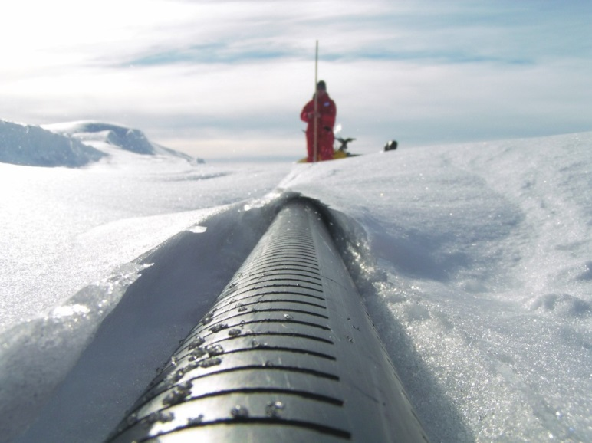
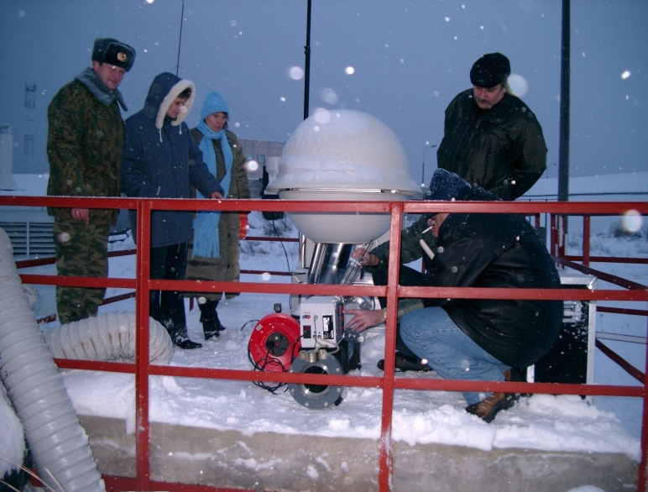
Challenge 1: completing installation and certification of remaining facilities
Political barriers
Challenging environments
Environmental regulations
Expense
IS27 Georg von Neumayer, Antarctica
RN61 Dubna

Slide 5
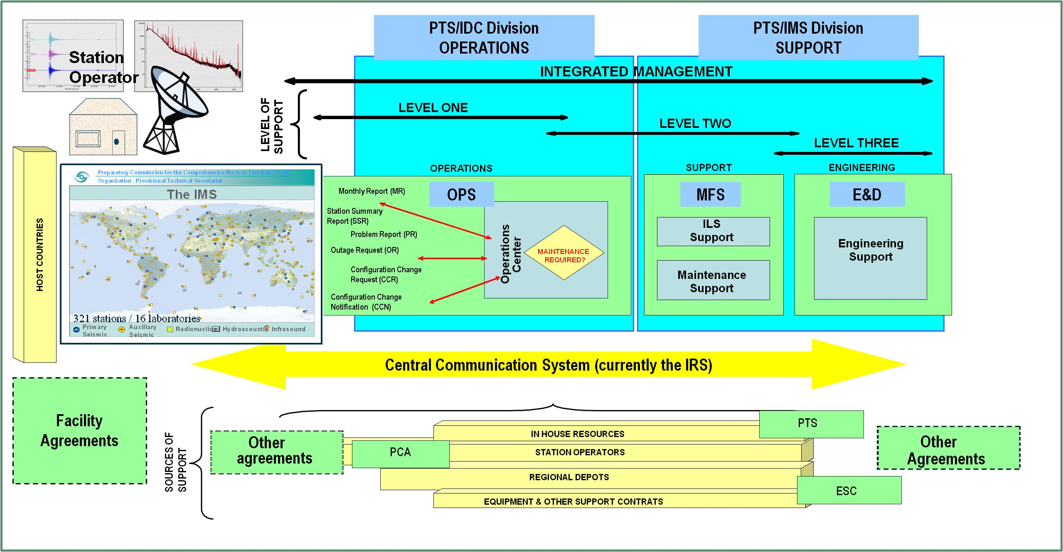
IMS Sustainment – Sources of Support
Challenge 2: IMS Sustainment

Slide 6
Auxiliary seismic stations – Data Availability
Serious issue that needs to be addressed
CTBTO will to continue to work with wider community on this issue

Slide 7
Facility Agreements
Total of 89 States to host stations – 49 facility agreements signed

Slide 8
Challenge 3: Continuous Improvement
Treaty Relevant Data
Calibrated
Meets sensitivity/capability requirements
Reliable and cost-effective IMS
Makes best use of technological advances and develops engineering solutions to:
Enhance sensitivity/capability of stations/network
Reduce cost of station construction and ongoing maintenance
Enhance data quality
Increase station uptime
Extend station life

Slide 9
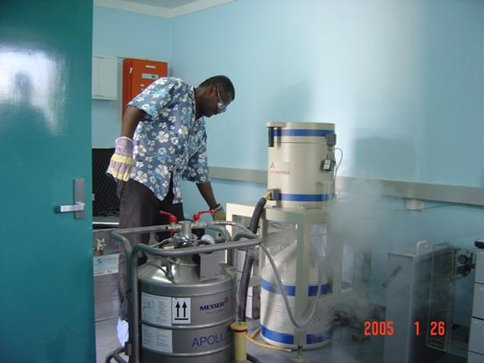
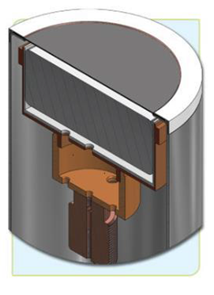
Hardening of stations/equipment
Improvement of power supply and grounding at stations:
Fundamental issue across the IMS
Poor quality of power is the major root cause for RN station failures
Continued improvement of HPGe detector reliability:
> Testing of new hardened detectors
HPGe detector

Slide 10
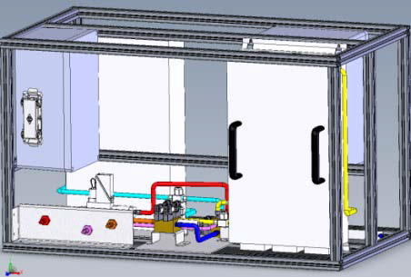
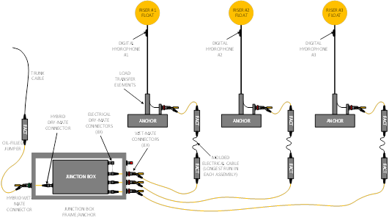
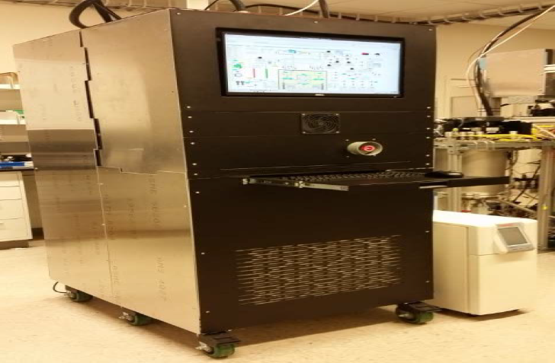
Examples of New Engineering developments
Next Generation
Noble-gas Systems
Developments on Modular Hydroacoustic Hydrophone Systems

Slide 11
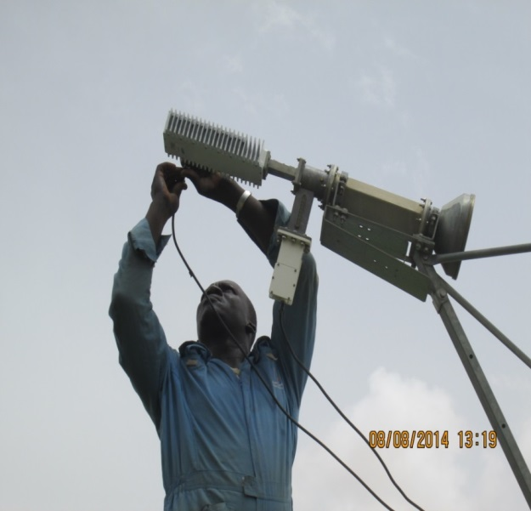
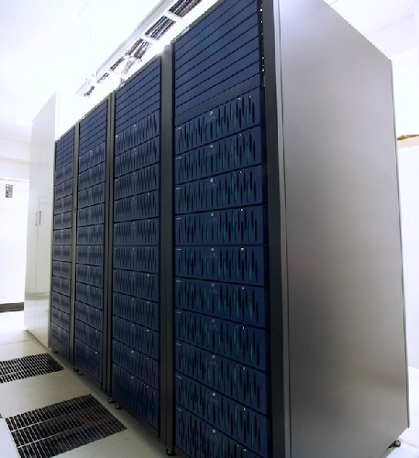
Challenge 4: data available and secure
Functional Global Communications Infrastructure
Robust information technology infrastructure
PKI integration and rollout

Slide 12
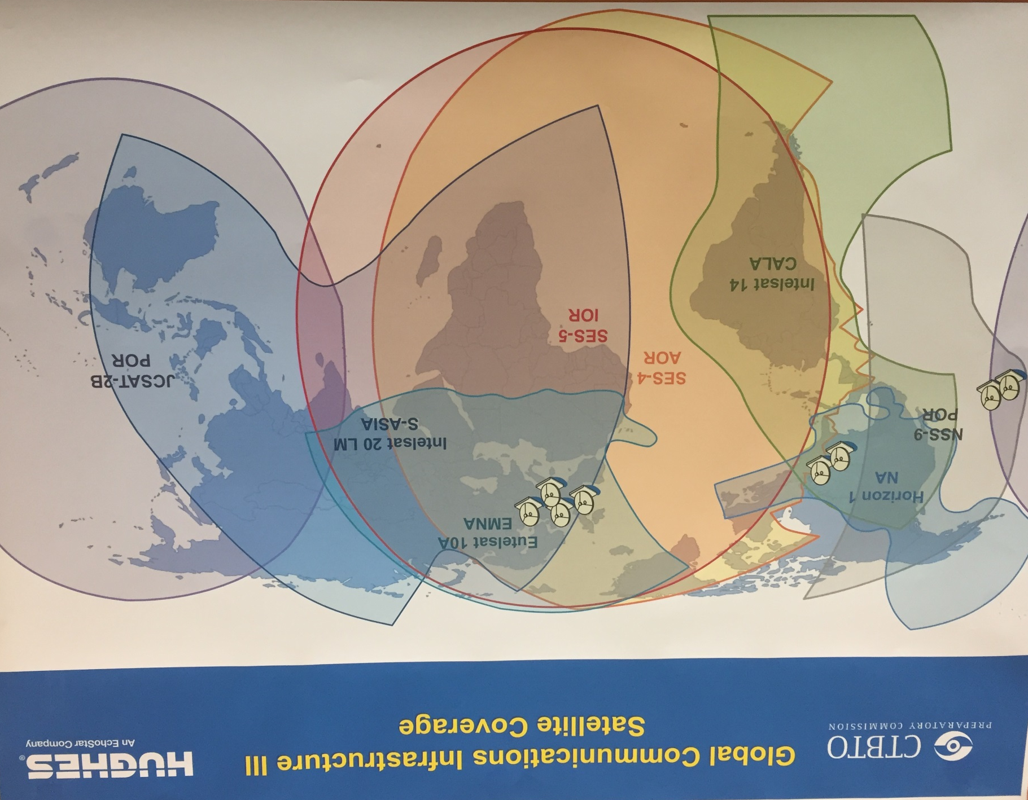
Transition to GCI-III
- implementation Nov 2016–Jun 2017
- your co-operation is essential
- increased bandwith
- redundacy

Slide 13
virtual Data Exploitation Centre (vDEC for Scientists)
Since 2011 vDEC became a component of CTBT’s strategy to engage and exchange knowledge with the scientific community.
A project funded by the EU
vDEC makes IMS data and IDC products available
How to get a cost-free contract:
Scientific organizations must submit a proposal to gain access to the data
Specify for what purpose(s) the data are needed and provide a description of the scientific research project.
For further info, email: vdec@ctbto.org.
Online submission of request: https://www.ctbto.org/specials/vdec/

Slide 14
Summary
IMS 91% complete
IMS is operationally ready
IMS has a proven capability
Ongoing challenges
Completion
Sustainment
technologically advanced
Security of data
Page 14

Slide 15
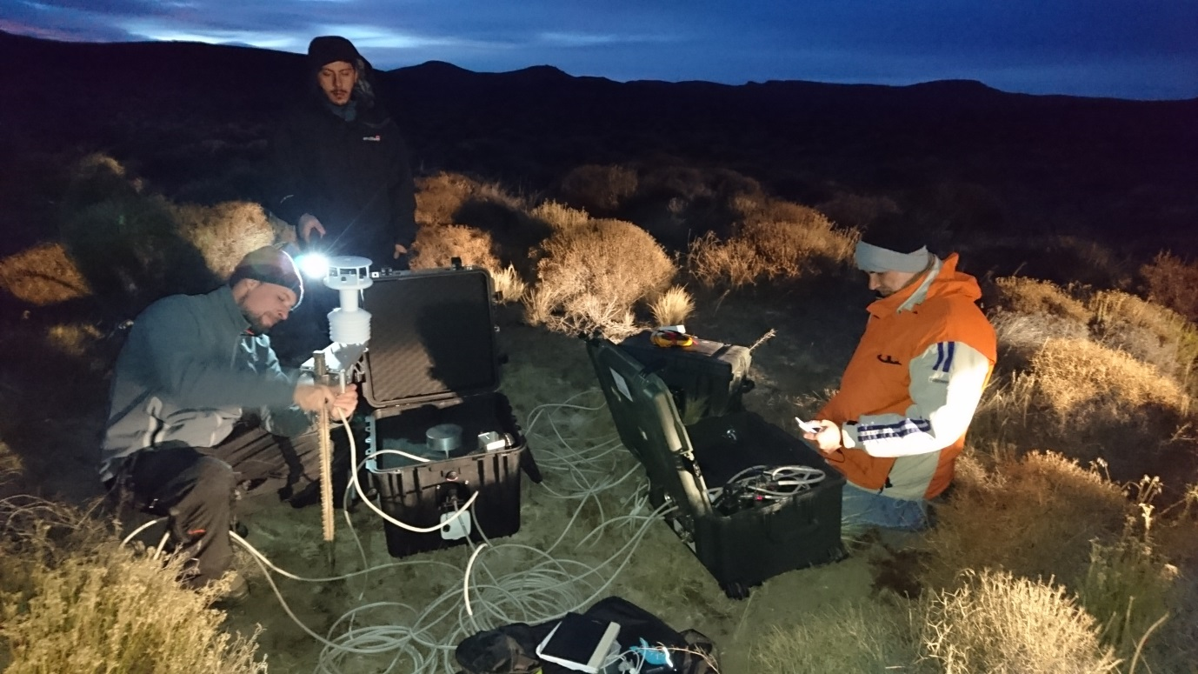
Thank you !
IS01 Argentina – site survey
IS43 (RF)
RN19 Chile, Noble Gas system upgraded in 2015

